Slide 1

GREENLEAF STORE PROJECT BY EFEOMO ASEKHAME

Slide 2
OVERVIEW OF GREENLEAF BUSINESS
GreenLeaf Stores was started in 2024 to make eco-friendly living easy and cheap for everyone.
The company saw that eco-conscious people in the U.S. wanted more eco-friendly home goods, like recyclable cleaning products, solar-powered lights, and tote bags that can be used more than once.
GreenLeaf was started by people who cared about the environment and knew how to run a business.
They made it a fully digital store so that they could reach customers all over the country and cut down on real retail waste.

Slide 3

KEY CHARACTERISTICS
Product Focus: Sustainable, reusable, non-toxic, and environmentally friendly home goods.
Target Market: Ten U.S. states' worth of environmentally conscious consumers, particularly millennials and Gen Z.
Early Success: Orders increased quickly in the first year, indicating high market demand.
CURRENT CHALLENGE
The company's lack of established data standards, despite its growth, put it at danger for
ineffective operations, ambiguous performance measurements, and possible financial loss.
THE SIGNIFICANCE
Sustainability and e-commerce are two significant themes that GreenLeaf is situated at the nexus
of in an era of rising environmental consciousness and digital-first shopping.
GreenLeaf has the potential to dominate its market and grow rapidly with the correct data
infrastructure and insight tools.

Slide 4
MAJOR PROBLEM OF THE GREENLEAF STORE
The main issue GreenLeaf is dealing with is:
Making decisions without following a methodical, data-driven process. This shows up in a number of important
ways:
Data chaos: Raw data that is unstructured, inconsistent, and lacking (e.g., mixed casing, missing prices).
Absence of KPIs Crucial metrics like revenue trends, product performance, and delivery
effectiveness are not visible to leadership.
Manual reporting: Because reports were created on the fly, they were ineffective, inconsistent,
and prone to mistakes.
Reactive decision-making: Instead of using data to inform judgments, guesswork
was used in the absence of real-time insights.

Slide 5
Objective of the Analysis – GreenLeaf Capstone Project
Specific Goals of the Analysis: Clean & Structure the Data
Defining Key Performance Indicators (KPIs)
Building a Dynamic Excel Dashboard
Generate Actionable Insights
Strategic Intent and Recommendation

Slide 6
Specific Goals of the Analysis
Clean & Structure the Data
Standardize inconsistent fields (product names, customer names).
Handle missing values (unit prices per quantity, unit cost per Quantity).
Add derived fields (Gross profit, monthly breakdowns ).
Defining Key Performance Indicators (KPIs)
Total Order : 1,000
Total Revenue: $117,278
Average Order Value: $21.40
Total Unit cost: $35,425
Gross Profit: $81,853
Delivery Rate : 60.2%
Monthly Revenue Trend: Revenue grows steadily from Jan–Apr, Slight dip in May,

Slide 7
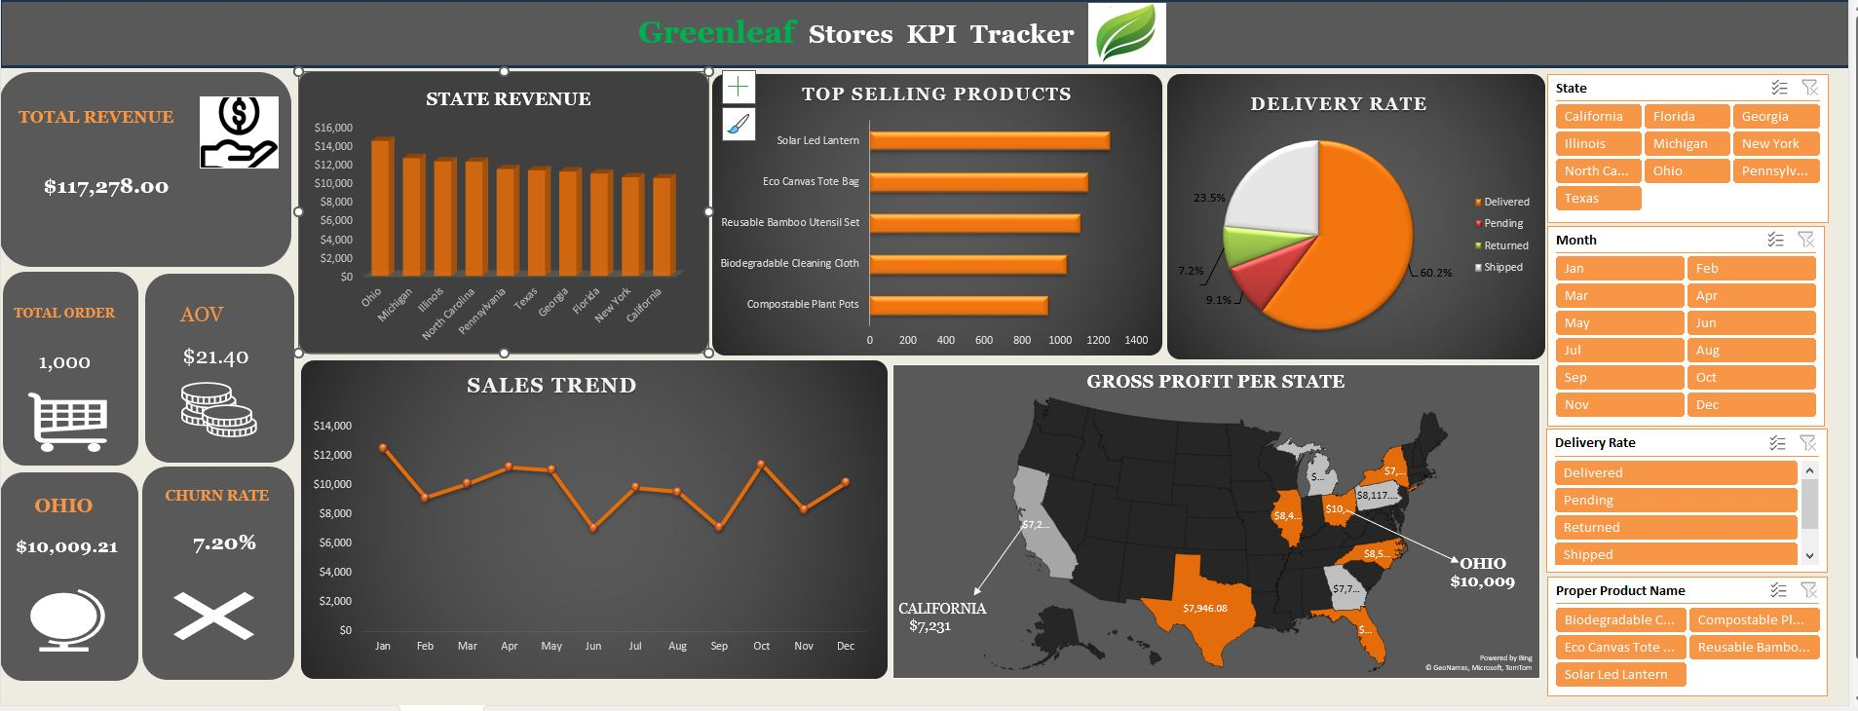
GREENLEAF DASHBOARD

Slide 8
Critical Analysis & Insights
Strengths:
Profit margin is strong (nearly 70%).
Rapid data transformation capabilities with Excel.
Defined, actionable KPIs to guide leadership.
Gaps / Risks:
May revenue dip needs root-cause analysis.
Customer-level insights (e.g., repeat purchases, churn) not clearly visualized.
Shipment status like returns and pending could erode margins.
Actionable Insights:
Leadership can now make data-backed decisions on pricing, inventory, marketing, and logistics.
Reduced reliance on instinct or ad hoc spreadsheets.

Slide 9
REC0MMENDATION
Investigate May Dip:
Analyzing product returns or inventory issues.
Reviewing marketing spend or delivery delays in that month.
Enhance Customer Segmentation:
Identify high-value, repeat customers for targeted promotions.
Add NPS/CSAT tracking.
Expand Dashboard:
Include category-level performance.
Add interactive filters (state, product category, shipment status).
Automate Data Refresh:
Link Excel to a live data source for daily/weekly refresh.

Slide 10
THANK YOU!!!!!!!!!

